Slide 1
Java – Exception Handling

Slide 2
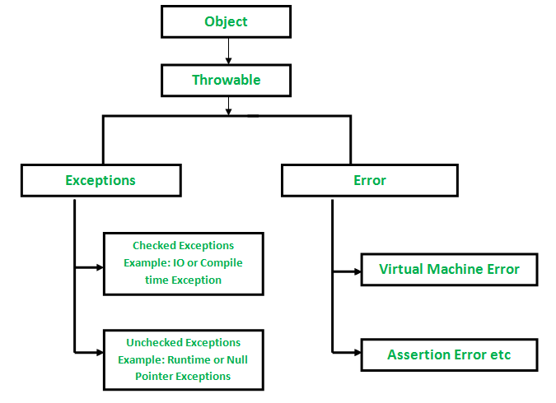
Exceptions in Java
What is an exception?
An Exception is an unwanted event that interrupts the normal flow of the program. When an exception occurs program execution gets terminated. In such cases we get a system generated error message. The good thing about exceptions is that they can be handled in Java. By handling the exceptions we can provide a meaningful message to the user about the issue rather than a system generated message, which may not be understandable to a user.

Slide 3
Exceptions in Java
Errors:
Errors are exceptional scenarios that are out of scope of application and it’s not possible to anticipate and recover from them, for example hardware failure, JVM crash or out of memory error. That’s why we have a separate hierarchy of errors and we should not try to handle these situations. Some of the common Errors are OutOfMemoryError and StackOverflowError
What are checked exceptions?
Checked exceptions are checked at compile-time. It means if a method is throwing a checked exception then it should handle the exception using try-catch block or it should declare the exception using throws keyword, otherwise the program will give a compilation error.
What are Unchecked exceptions?
Unchecked exceptions are not checked at compile time. It means if your program is throwing an unchecked exception and even if you didn’t handle/declare that exception, the program won’t give a compilation error. Most of the times these exception occurs due to the bad data provided by user during the user-program interaction. It is up to the programmer to judge the conditions in advance, that can cause such exceptions and handle them appropriately

Slide 4


